Slide 7
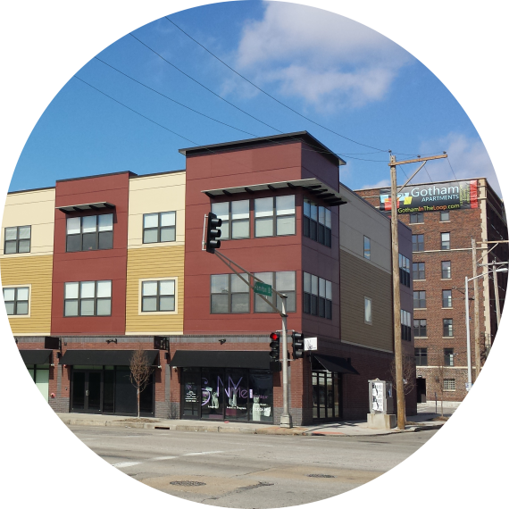
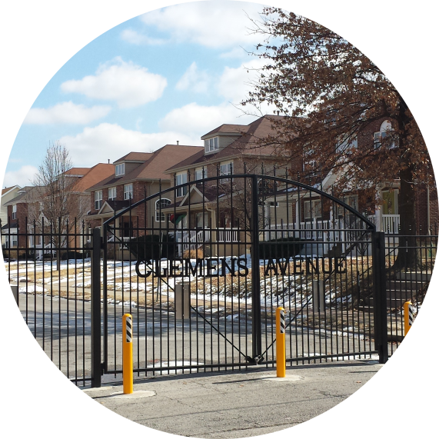
Opportunities for TOD development do exist throughout the corridor and have begun:
Transit Oriented Development Plan (2013) which includes Form-based zoning
Loop Trolley station development
Washington University North Campus
St Vincent Greenway
Metro Garage & Parking Lot
Strong housing development within ½ mile of transit

