Slide 1
Central CORRIDOR TRANSIT ACCESS STUDY
Citizens for Modern Transit
March 27, 2014

Slide 2
PROJECT INTRODUCTION

Slide 3
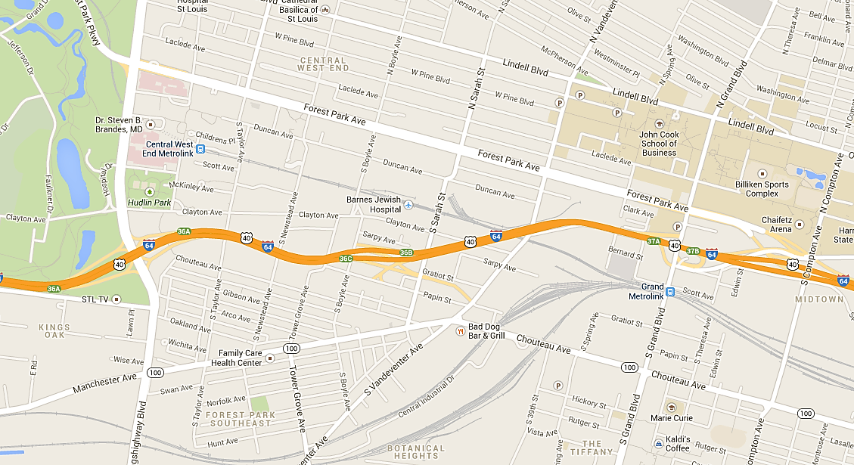
study area

Slide 4
Why this study?
Central Corridor growth is increasing demands for transit
Transit infrastructure improvements desired and there is a need to:
Objectively consider the merits of the improvements
Adhere to an FTA study process for modifications to Federal investments

Slide 5
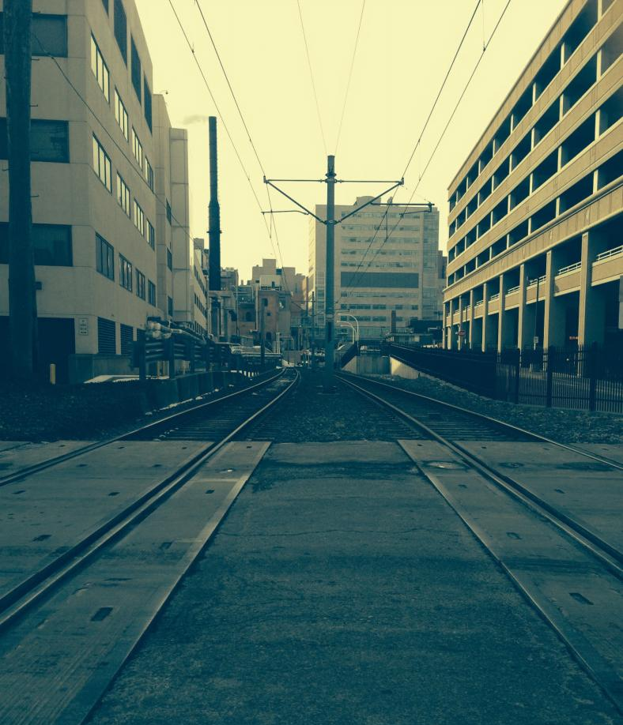
Study Goals
Present regional leaders with an objective analysis to support decision-making
Deliver a defensible transit solution that provides a path forward towards implementation

Slide 6
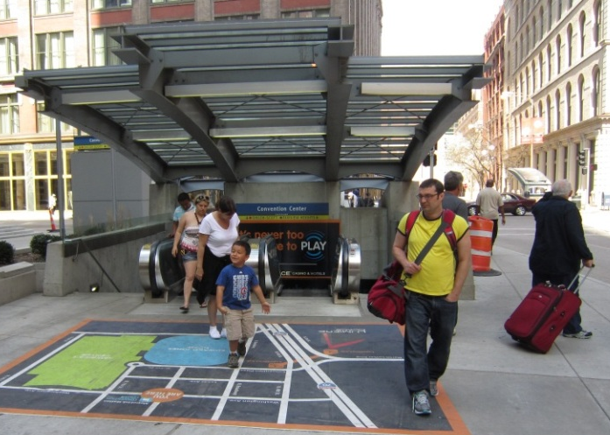
STUDY PROCESS
Analysis & feasibility study of transit alternatives
Evaluation of benefits, costs, and ramifications
Data-driven & objective
Qualitative
Stakeholder engagement

Slide 7
What ARE THE ALTERNATIVES?
No system change
Build MetroLink station in Cortex between Boyle Ave and Sarah St
Build MetroLink station AND relocate Central West End Transit Center to Cortex
Upgrade Central West End MetroLink Station

Slide 8
Project team
Project Lead is Citizens for Modern Transit
Metro served as Project Manager
Bernardin, Lochmueller & Assoc. – Consultant
Parsons Brinckerhoff – Sub-consultant
David Mason & Associates – Sub-consultant
H3 Studio – Sub-consultant
Innis Consulting – Sub-consultant

Slide 9
Stakeholder engagement
Stakeholder Interviews
Met individually with 10 groups representing stakeholders, residents, and community groups
Advisory Committee
Met 3 times with stakeholder advisors to receive guidance and direction
Technical Committee
Met 5 times with technical advisors to review assumptions, data, and analyses

Slide 10
background

Slide 11
Central corridor Today
Premier Growth Area in St. Louis City
Cortex (CIC, @4240, BJC @ The Commons)
Barnes/WU Campus Renewal Plan
IKEA
Shriner’s Hospital/College of Pharmacy
2,300 new jobs by the end of 2015
As many as 12,000 new jobs by 2035

Slide 12
Central corridor Today
Residential Developments
Laclede Lofts
West Pine Bottling
CityWalk
Adventura
1,000 new residents by the end of 2015

Slide 13
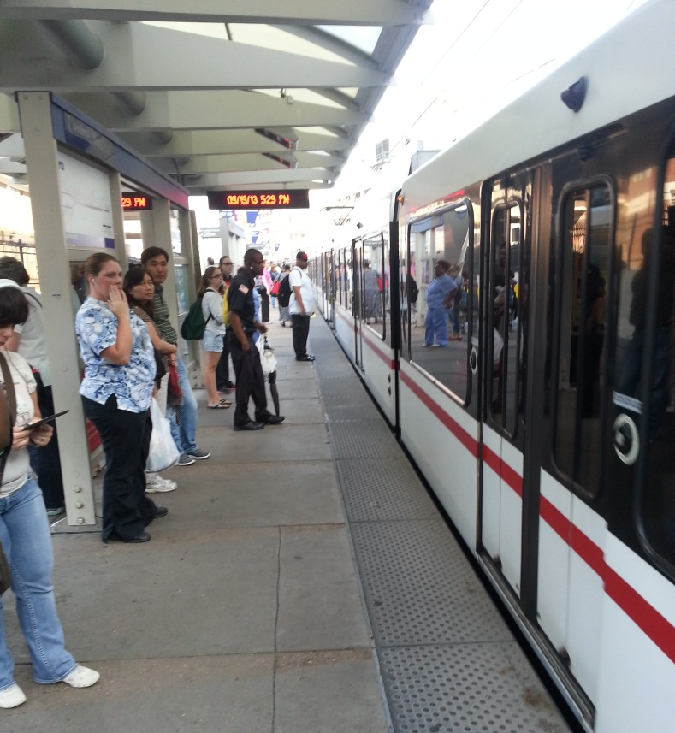
Central corridor today
CWE MetroLink Station
Platform crowding
Crowding on stairwell and pathway to Transit Center
Busiest station
Daily ridership = 5,695

Slide 14
Cortex Metrolink station

Slide 15
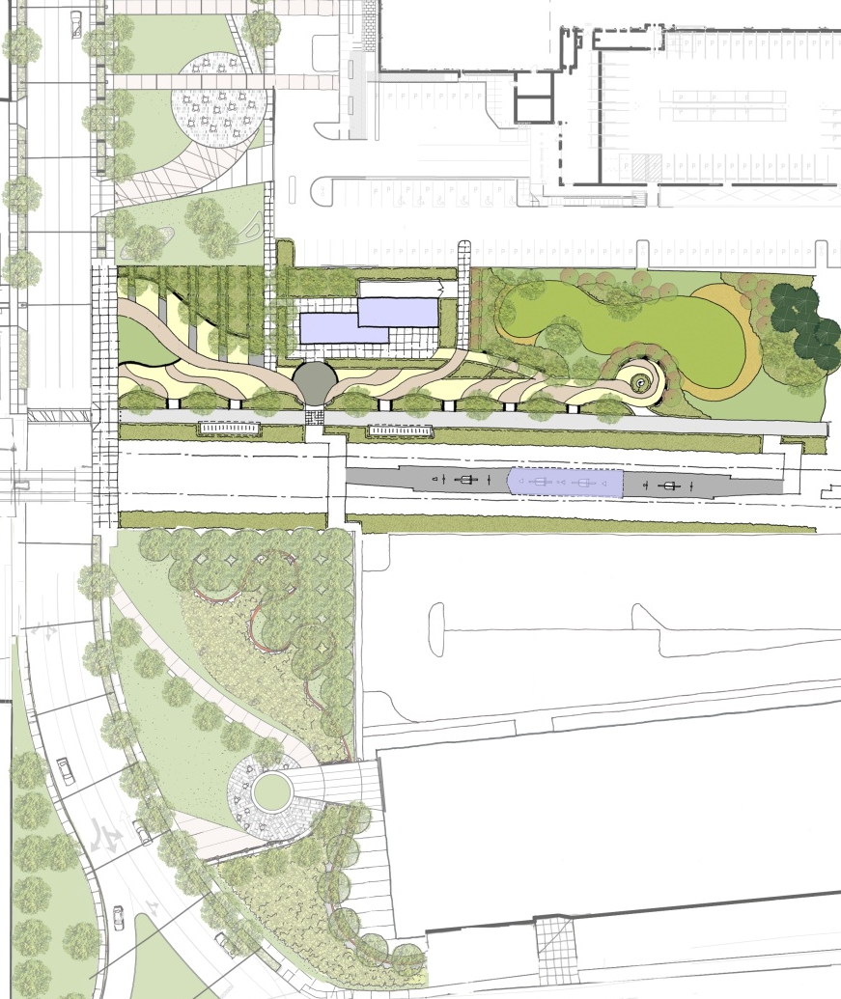
CORTEX METROLINK station
@4240
Adjacent to Boyle Ave
Single, center platform
ADA-compliant pedestrian & bicycle access from Boyle Ave & Sarah St
Direct pedestrian access to Cortex Commons
Boyle Ave
BJC at the Commons

Slide 16
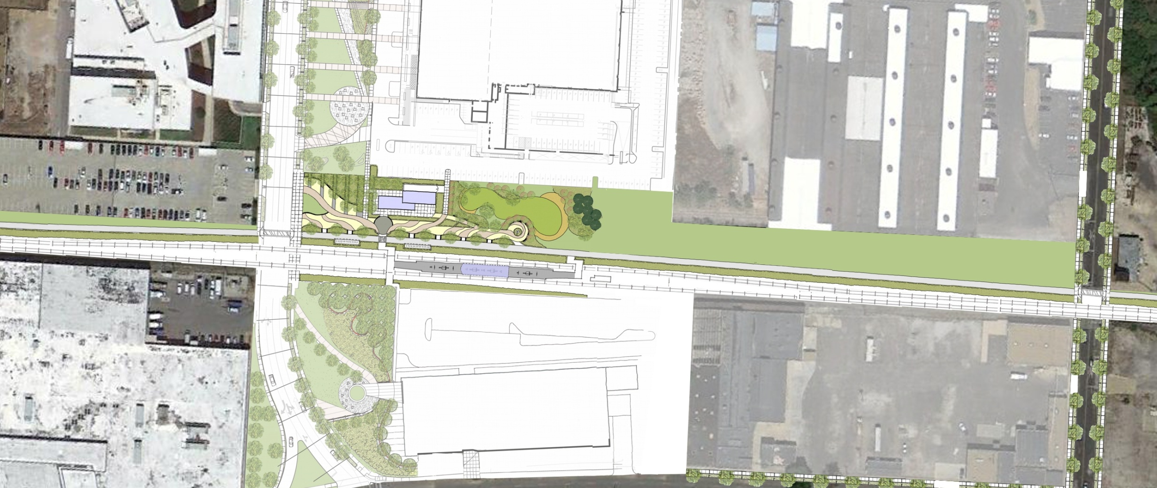
CORTEX METROLINK station
@4240
Sarah St
Boyle Ave
BJC at the Commons

Slide 17
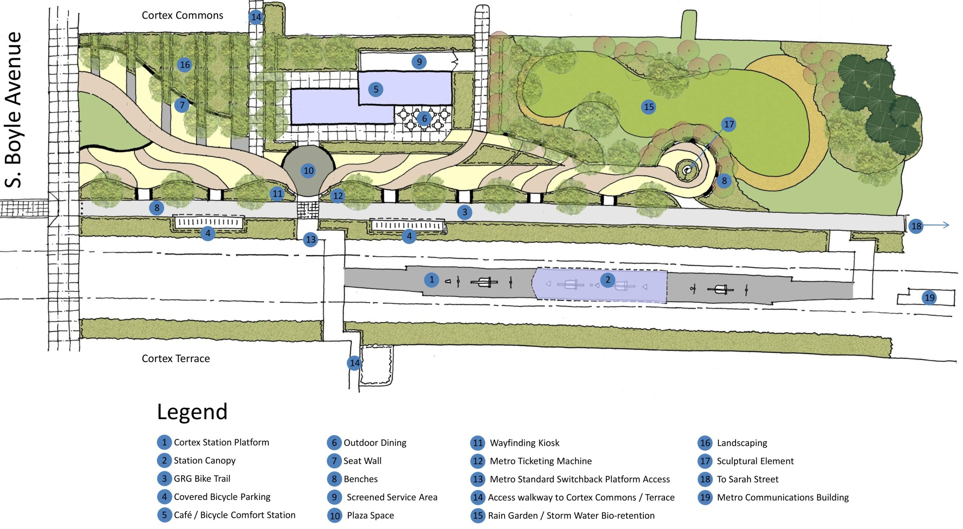
CORTEX METROLINK station

Slide 18
cortex metrolink station
Ridership forecasted for 5 scenarios, including low and high growth for 2025 and 2035
2015 boardings would place this station near the median of existing stations
 | 2015 | 2025 Low | 2025 High | 2035 Low | 2035 High
Cortex Station Boardings | 890 | 1,176 | 1,597 | 1,419 | 1,907
Net New Boardings | 778 | 869 | 1,447 | 1,123 | 1,644

Slide 19
cortex metrolink station
Capital Costs = $9.4 Million
Annual Incremental Operating Costs = $835,000
Impact to existing MetroLink riders traveling through station: 1 minute of travel time plus 20 seconds of dwell time
No scheduling impacts to Metro

Slide 20
Evaluation and Conclusion

Slide 21
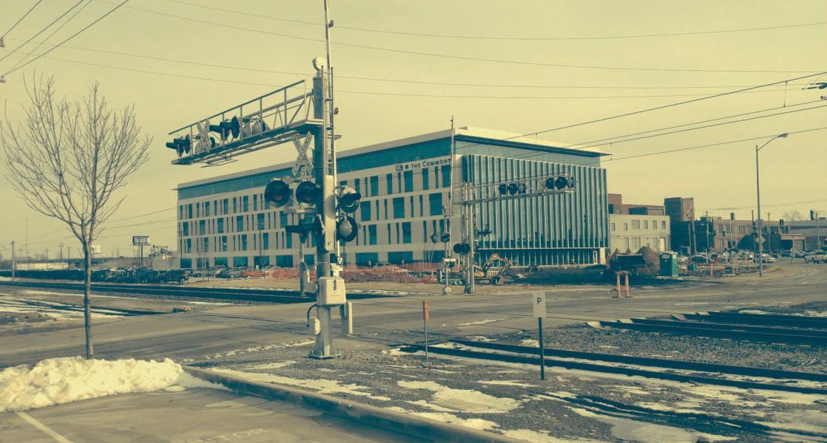
Project Objective
Stimulate regional economic development by expanding high-performance transit service to connect Cortex with major destinations

Slide 22
Evaluation Considerations
Transit Ridership
Implementation
Transit User Experience
Transit Operations
Safety & Accessibility
Economic Development
Quality of Life
Financing

Slide 23
Conclusion
New MetroLink Station in Cortex Satisfies Project Objective
Economic Development
Support continued job creation
Bolster momentum for redevelopment
Contribute to neighborhood revitalization & foster TOD opportunities

Slide 24
conclusion
Quality of Life
Maximizes multi-modal connectivity
Potential Bus Rapid Transit
Park and Ride
Tower Grove/GRG pedestrian & bicycle corridors
Reduces traffic and parking in Cortex
Offers expanded transportation choices and access to opportunity

Slide 25
conclusion
Transit
Attracts new transit riders
Ridership sufficient to justify a new station
Minimal impact on existing riders
Minimal impact on transit operations
At-grade site available for new station
Recommendation = Build New Station in Cortex

Slide 26
Next steps
Finalize strategies for financing capital and operating costs
Submit study to Metro & FTA for approval
Project adopted by East-West Gateway
Environmental, design, and engineering
Construction

